Slide 1

Telangana Growth Analysis
Introduction
Telangana, the 29th state of India, was formed in 2014 with Hyderabad as its capital.
The state has witnessed remarkable economic growth, surpassing national averages.
This presentation delves into the key factors driving Telangana's growth across 3 sectors.
Key sectors in Telangana are Information Technology (IT), manufacturing, pharmaceuticals, and agriculture.

Slide 2
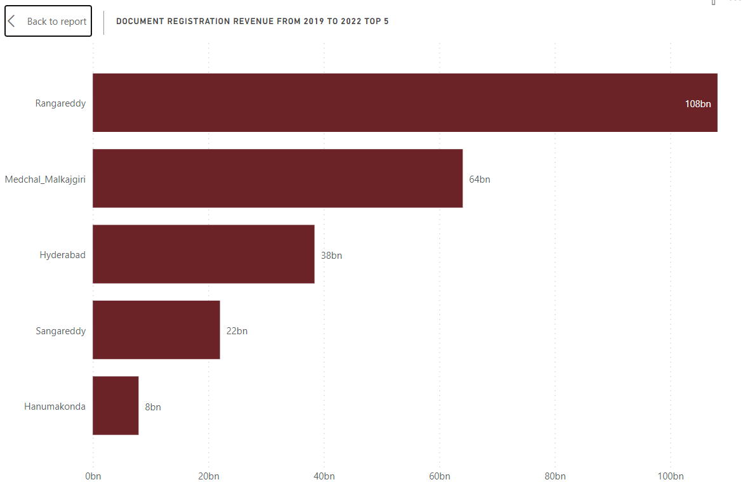
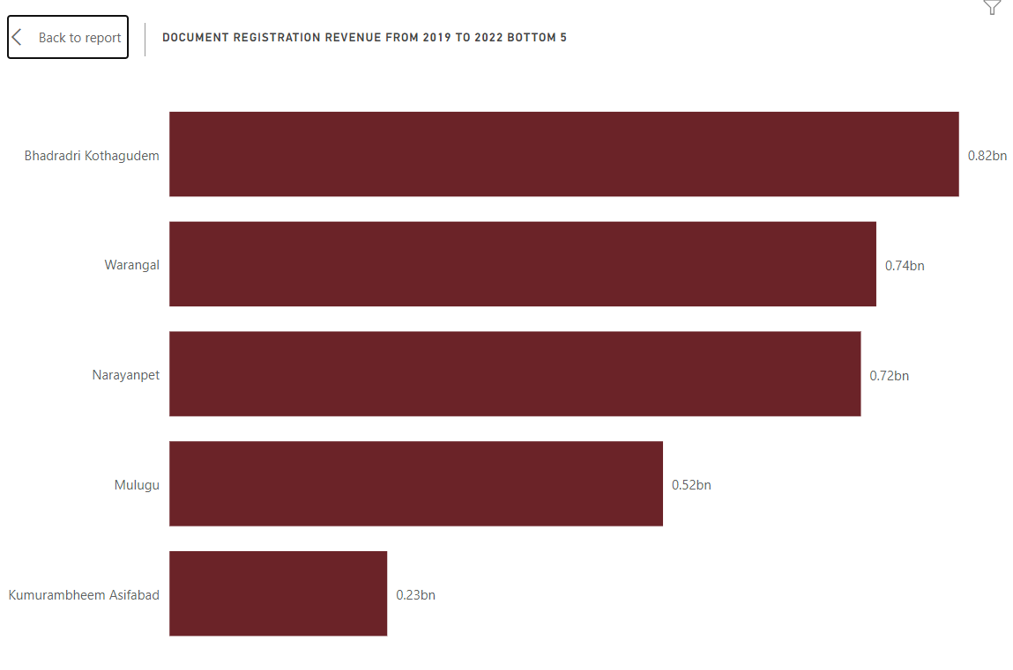
Stamp Registration Revenue
1. How does the revenue generated from document registration vary across districts in Telangana? List down the top 5 districts that showed the highest document registration revenue growth between FY 2019 and 2022.

Slide 3
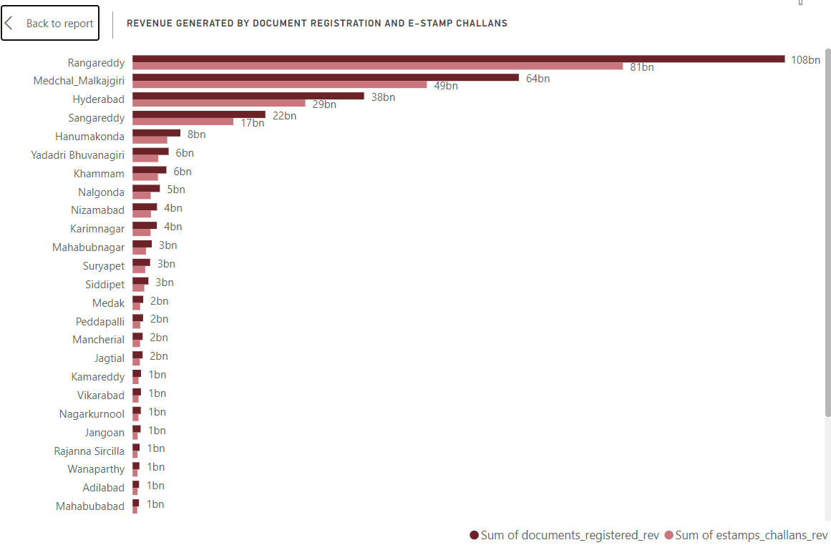
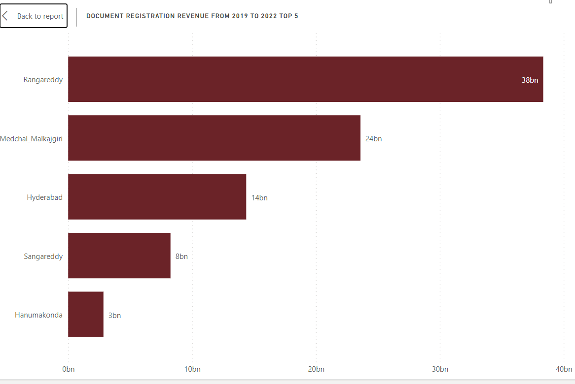
2. How does the revenue generated from document registration compare to the revenue generated from e-stamp challans across districts? List down the top 5 districts where e-stamps revenue contributes significantly more to the revenue than the documents in FY 2022.

Slide 4
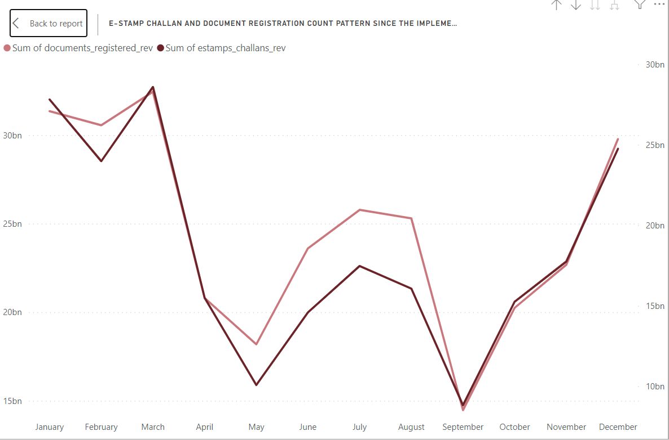
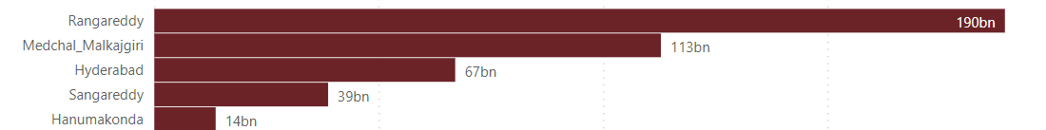
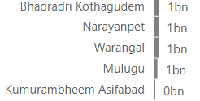
3. Is there any alteration of the e-Stamp challan count and document registration count pattern since the implementation of the e-Stamp challan? If so, what suggestions would you propose to the government?
Yes, After the introduction of E-Stamps the revenue from document registration has gone down.
The reasons may be because e-stamps are easy to use, time saving, and cheaper.
4. Categorize districts into three segments based on their stamp registration revenue generation during the fiscal year 2021 to 2022.
Districts with more than 10bn revenue
Districts with less than 2bn revenue

Slide 5
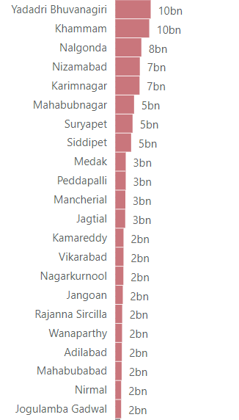
Districts with less than 10bn and more than 2bn revenue

Slide 6
Transportation Revenue
5. Investigate whether there is any correlation between vehicle sales and specific months or seasons in different districts. Are there any months or seasons consistently showing higher or lower sales rates, and if yes, what could be the driving factors? (Consider Fuel-Type category only)
No correlation exists between vehicle sales and specific months in different districts.
But Hyderabad, Medchal Malkajgiri, Rangareddy, and Sangareddy are always in the top districts generating revenue in vehicle sales, and Kumarambheem Asifabad, Jangoan, and Wanarpathy are always in the last position.
6. How does the distribution of vehicles vary by vehicle class (MotorCycle, MotorCar, AutoRickshaw, Agriculture) across different districts? Are there any districts with a predominant preference for a specific vehicle class? Consider FY 2022 for analysis.
People in Hyderabad and the districts surrounding Hyderabad predominantly prefer motor cars to any other vehicle. 74% of total vehicle sales were motor cars in these districts.

Slide 7
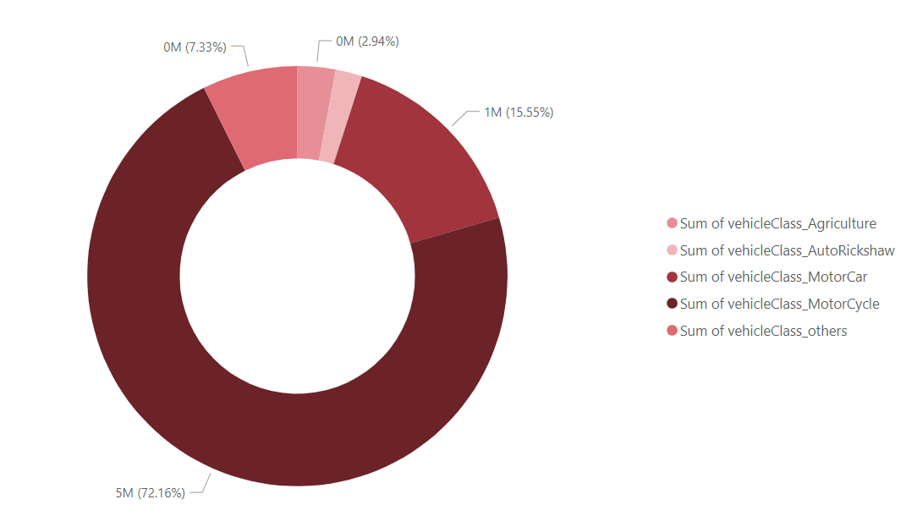
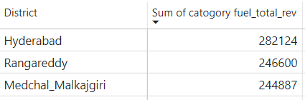
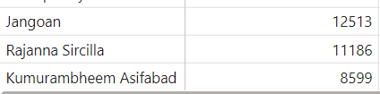
7. List down the top 3 and bottom 3 districts that have shown the highest and lowest vehicle sales growth during FY 2022 compared to FY 2021? (Consider and compare categories: Petrol, Diesel and Electric)
The top 3 districts that have shown highest vehicle sales growth in FY 2022 compared to FY 2021
The top 3 districts that have shown lowest vehicle sales growth in FY 2022 compared to FY 2021

Slide 8
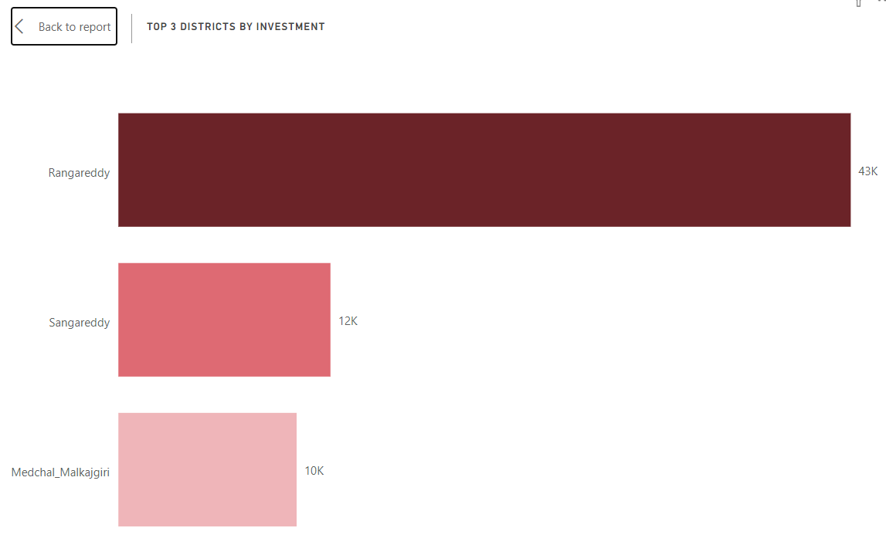
TS-IPASS REVENUE
8. List down the top 3 districts that have attracted the most significant sector investments during FY 2019 to 2022. What factors could have led to the substantial investments in these particular districts?
Reasons:
Proximity to Hyderabad
Industrial and IT Growth
Government Policies
Infrastructure Development
Special Economic Zones (SEZs) and Industrial Parks
Skilled Workforce
Natural Resources

Slide 9
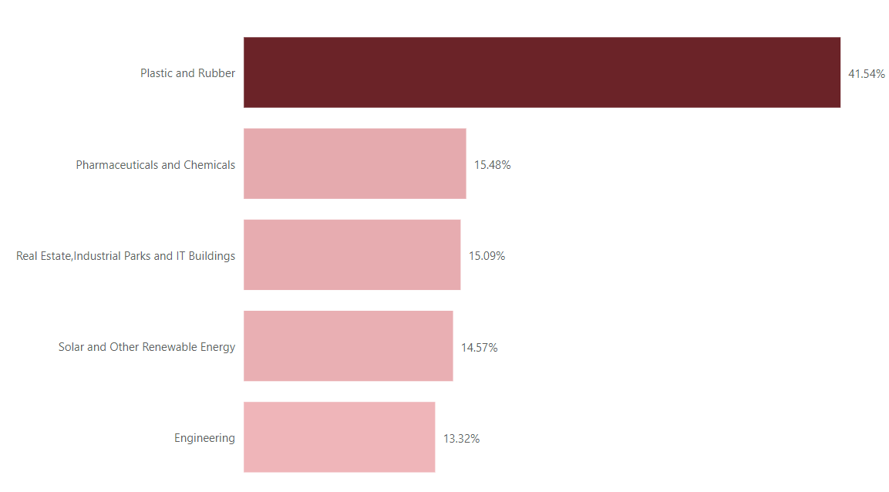
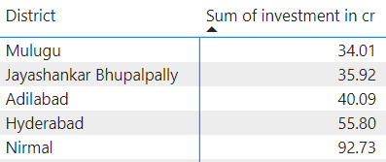
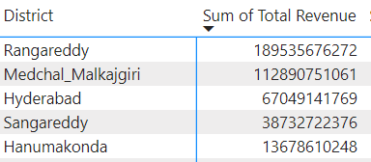
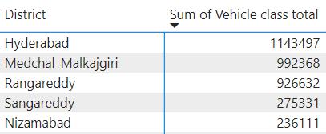
9. List down the top 5 sectors that have witnessed the most significant investments in FY 2022.
The top 5 sectors that have witnessed the most significant investment in the FY 2022
10. Is there any relationship between district investments, vehicle sales, and stamp revenue within the same district between FY 2021 and 2022?
No, except Hyderabad there are no common districts between district investments, vehicle sales, and stamp revenue.

Slide 10
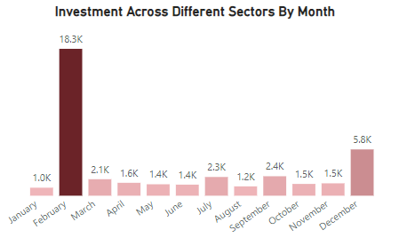
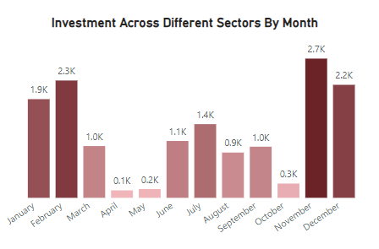
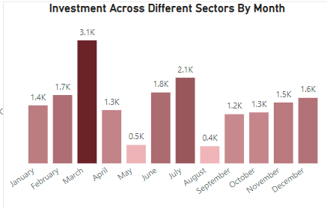
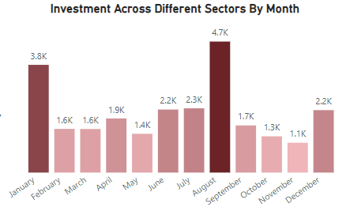
11. Can we identify any seasonal patterns or cyclicality in the investment trends for specific sectors? Do certain sectors experience higher investments during particular months?
2019
2020
2021
2022
No, there is no seasonal patterns or cyclicality in the investment trends for specific sector.

Slide 11
SECONDARY RESEARCH
What are the top 5 districts to buy commercial properties in Telangana? Justify your answer.
Hyderabad: Being the capital city and a major economic hub, different zones within Hyderabad, such as HITEC City, Gachibowli, Banjara Hills, and Secunderabad, have been prime locations for commercial investments.
Rangareddy: This district, adjacent to Hyderabad, has seen significant commercial development, especially along the IT corridor and industrial zones.
Medchal Malkajgiri: This district, due to its proximity to Hyderabad, has attracted attention for commercial and industrial investments.
Sangareddy: With its strategic location and connectivity, Sangareddy has become a focus for industrial and commercial developments.

Slide 12
2. The current government implemented what significant policies or initiatives to enhance economic growth, investments, and employment in Telangana? Can we quantify the impact of these policies using available data?
TS-iPASS (Telangana State Industrial Project Approval and Self-Certification System): TS-iPASS is an industrial policy launched by the Telangana government to facilitate a hassle-free and transparent process for businesses to obtain necessary approvals for setting up industries. The streamlined process aims to attract investments and promote ease of doing business in the state.
T-Hub: T-Hub is India's largest startup incubator located in Hyderabad. It is an initiative to support and nurture startups, fostering innovation and entrepreneurship in the state. This initiative is expected to contribute to job creation and economic growth.
Industrial and Investment Promotion Policy: The Telangana government introduced an industrial policy focused on promoting key sectors, including IT, manufacturing, and pharma. The policy includes incentives such as subsidies, tax benefits, and infrastructure support to attract investments.
Rural Development Initiatives: The government had also focused on rural development initiatives, including the Mission Kakatiya program for the restoration of tanks and the Mission Bhagiratha program for providing safe drinking water. These initiatives aim to improve rural infrastructure and livelihoods.
These policies have helped for the steeped rise in today’s economic growth of Telangana. However, the exact impact cannot be seen in the given data set because they were put into practice when Telangana was newly formed.

Slide 13
3. Provide top 5 Insights & and 5 recommendations to the Telangana government for sustained growth in the next 5 years based on your analysis.
Stamp registration revenue provided the highest revenue among all the given different revenue, which is followed by transportation revenue and TS-IPASS revenue.
In the coming years, E-stamp will continue to generate more revenue compared to document registration and even surpass it by a large margin.
Motorcars are the most bought and preferred vehicle in Telangana and their demand will continue to increase in the future (especially in Hyderabad and the cities surrounding it).
The demand for vehicles other than motorcars and motorbikes has been decreasing over the years.
Real estate, IT buildings, and industrial parks are the most booming sector recently.
My recommendations to the Telangana government will be:
Identify and promote industries with high growth potential to reduce dependency on specific sectors.
Invest in education and skill development programs to enhance the capabilities of the workforce.
Foster collaborations between industries and educational institutions to ensure that skills align with market demands.
Focus on the districts that are falling behind in terms of revenue and technology compared to other districts.

